Slide 1
A Safe Environment for Every Kid SEEK MOC 4/PI Self-Directed Clinical Activity Webinar 3
Howard Dubowitz, MD, MS, FAAP

Slide 2
SEEK Materials – Webinar 3
SEEK webinar 3 PowerPoint
AAP Policy Statement on Effective Discipline
SEEK Core Components Practice Self-Assessment

Slide 3
Harsh Punishment Positive Discipline

Slide 4
Background
Physical punishment (PP) → harm
Harsh verbal punishment → harm
Based on science: PP ~ child maltreatment (CM)
American Academy of Pediatrics – no spanking, encourage alternatives
Goal: help parents with disciplinary approaches to optimize children’s health, development, wellbeing and safety
Notes:
Stress verbal
Bottom line

Slide 5
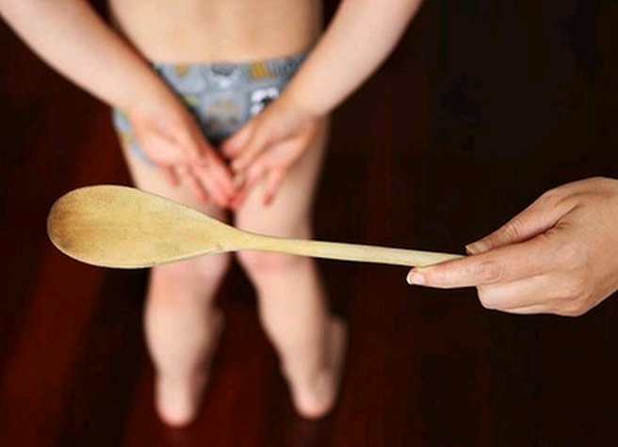
Evidence: The Impact of Physical Punishment (>300 articles)
In Childhood
Aggression
Moral internalization
Anti-social behavior
Worse parent-child relationships
Behavior problems
Physical abuse
In Adulthood
Aggression
Criminal behavior
Mental health problems
Abuse of one’s own child, spouse
Notes:
Moral internalization – belief that one is bad

Slide 6
Definitions
Punishment
Imposing a penalty for an offense
Spanking = hitting
Striking the buttocks to cause physical pain, generally with open hand
If with an implement: paddling, belting, caning, whupping
Verbal Abuse
Nonphysical punishment that’s cruel, degrading
Belittles, humiliates, denigrates, scapegoats, threatens, scares, ridicules
Discipline
Teaching about expectations, guidelines, principles
Notes:
Start using hitting, rather than euphemisms

Slide 7
Prevention
Timing: 1st 6 mos. of age
By 8 mos., 8% of parents report hitting (Zolotar et al. Front Psychiatry 2011)
Help build healthy parent-child relationships
Notes:
Negotiation
child feeling felt, attachment → promote social emotional health

Slide 8
Help Build Healthy Parent – Child Relationships
The heart of our work, the foundation for discipline
Consider parent’s abilities, needs, interests
Parents need to understand child’s behavior, development
Critical for having reasonable expectations
Recognize and respond to child’s cues/needs. Be present!
Time in
Encourage open, clear communication
Respect child’s right to express emotions
Hurting someone or oneself or damaging property - not OK
Notes:
2nd bullet: Most parents most of the time want things to be good for their child
Time in: Special time + regular time like enjoying a meal together
Clear communication: praising child who reported SA

Slide 9
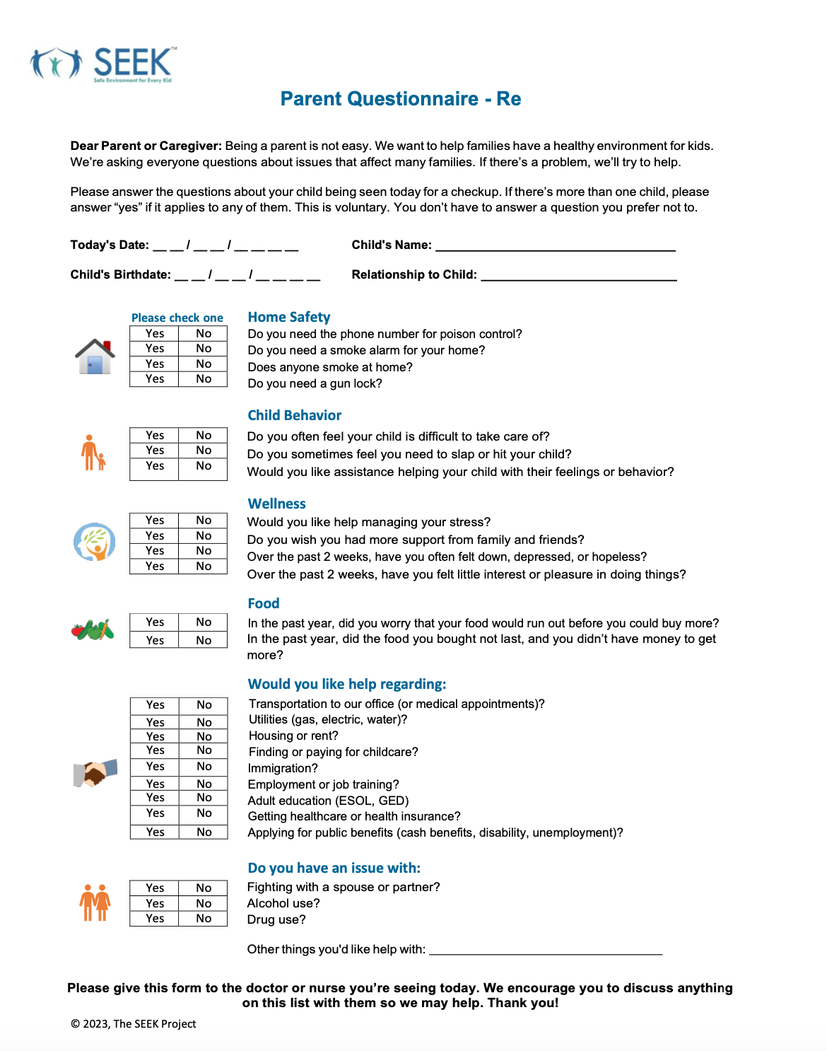
Prevention
Help address risk factors for punishment and abuse
e.g., Severe stress, poor coping, substance misuse,IPV
Pediatric primary care: systematic structured screening
e.g., the Safe Environment for Every Kid (SEEK) model
Do you often feel your child is difficult to take care of?
Do you sometimes find you need to slap or hit your child?
Would you like assistance helping your child with their feelings or behavior?
Notes:
Structured - important

Slide 10
SEEK REAP Approach
Reflect: It sounds like taking care of ___ isn’t easy.
Empathize: It can be tough to be a parent, and a kid.
Assess:
Triggers? The most difficult behavior.

Slide 11
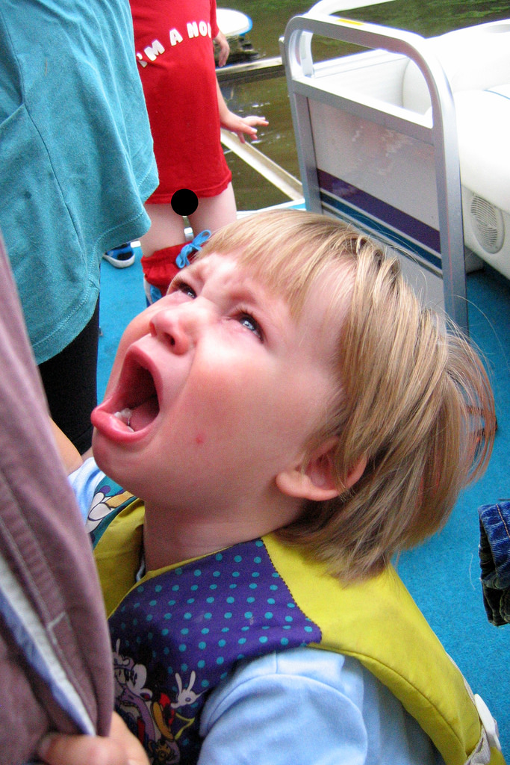
Child Factors Contributing to Difficult Behavior
Difficult temperament
ADHD
Intellectual/learning disability
Hearing problem
Language disorder
Sleep deprivation
Mood disorder
Traumatic experiences
Parental perception of “difficult” behavior
Notes:
Parent’s perception of child - eg, lazy enuretic,
But don’t assume all fine with kid
Disruptive
Oppositonal defiant

Slide 12
Assessment - Understanding Parents
Parent may think punishment is necessary, even good
Why?
How they were raised
Little understanding of child development, behavior
Don’t know alternatives
Stress - struggling to cope, little support
Religious belief
Understand and address the basis for parent’s stance

Slide 13
Parents’ Stance Toward Physical Punishment
Strongly Against Ambivalent Strongly For
Readiness to Change

Slide 14
Assess Incorporate Principles of Motivational Interviewing
What things make it necessary to spank ___?
Why do you think ___ does that?
What works?
What else have you tried?
What else could you try?

Slide 15
Motivational Interviewing
Identify where parent is re. ‘readiness to change’
Pre-contemplation, contemplation, preparation, action, maintenance
Motivate
Elicit their ideas of the issue, what to do
Jointly develop a plan – attainable goals
Follow-up, affirm any progress
Bolster commitment to change
Notes:
In 320 middle-class, intact families:
83% used corporal punishment
25% weekly, 4% every day
35% use an object
85% say they would rather not use it
Graziano et al., Pediatrics 98(4), 1996

Slide 16
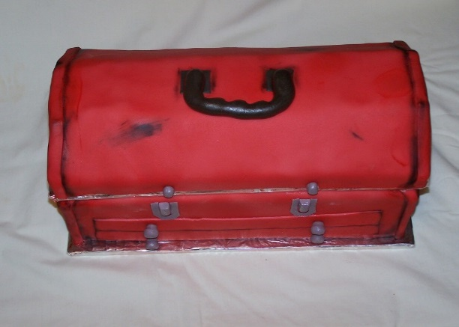
Plan – A Light Touch
Ask permission to discuss alternatives (MI)
“Would you like (more) help?”
No preaching, admonishing
Time out for parent (“give yourself a break!”)
Convey concern about hitting
Child learns hitting is the way to deal with angry feelings
Does not work well
There are better ways to teach
Add to parent’s ‘toolbox’
Notes:
Tool box – some new and improved tools

Slide 17
General Points
Professionals and parents are role models
Educate parent about normal development and behavior
Acknowledge it can be challenging. Reasonable expectations
Nothing works overnight!
Kids do need rules/limits, consistency, and flexibility
Use least intrusive approach that works (eg, give child choices)
Notes:
how we approach active kid in office touching desk
Last bullet: do you want the blue or green shirt

Slide 18
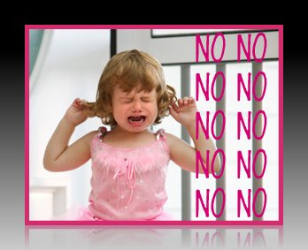
More General Points
Prioritize what to work on
Dangerous, destructive, hurtful behavior
Suggest no hitting
Planned ignoring ... extinction (eg. temper tantrums)
Perfect the art of distraction
Help child understand why a behavior is problematic
Notes:
Pick one’s battles, not sweating the small stuff
Planned ignoring – negative reinforcement

Slide 19
Guidelines for Approaching Possible Harsh Punishment
Do you often feel your child is difficult to take care of?
Would you like assistance helping your child with their feelings or behavior?
Do you sometimes feel you need to slap or hit your child?
Yes
Yes
Yes
It sounds like taking care of isn’t easy? It can be tough to be a parent, and a kid.
What behavior is MOST difficult for you? How do you handle this? How’s it working?
I am concerned that’s what’s happening is not good for and not for you.
Can we discuss some other things to try?
If slapping/hitting, how often? With what?
How’s it working? How do you feel after you’ve slapped ?
What else have you tried? How’s that working?
May I suggest a few things? We’ve learned good ways to teach kids.
no hitting contract
praise - power of positive reinforcement
prioritize - clear, simple rules for dangerous or damaging behavior
consistency - all caregivers
active ignoring - not sweating small stuff
patience - won’t change overnight
Would you like (more) help?
Yes
No, other reason
No, getting enough help
What kind of help would you consider?
e.g., partner/spouse, family, a mental health professional,
child’s daycare or teacher, parenting classes, religious group
What might be the benefit of getting help?
Encourage getting help
What makes it hard to get help?
Suggest barriers, address them
What would make it easier to get help?
Offered help
Gave parent handout Made referral
in-house or community
F/U
Supported parent’s choice
Reassured
Gave parent handout F/U
No action needed
© 2023, SEEK

Slide 20
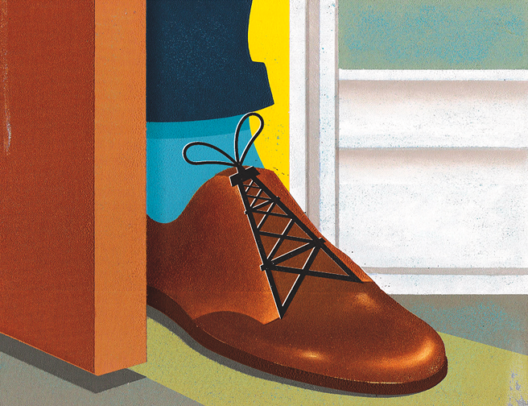
Getting a Foot in the Door
We’ve learned better ways to teach kids. Can we talk about them?
Does hitting ___ work?
Not really, maybe for a few minutes!
How do you feel after you spank ___?
Pretty bad!
Notes:
The effects of corporal punishment were transient: within 10 minutes, most children (73%) had resumed the same behavior for which they had been punished.
You’d be more wonderful – depends on the relationship. If I feel like being a bit playful.
In 320 middle-class, intact families:
83% used corporal punishment
25% weekly, 4% every day
35% use an object
85% say they would rather not use it
Graziano et al., Pediatrics 98(4), 1996

Slide 21
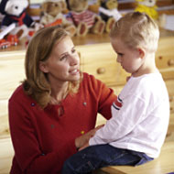
Positive Discipline
Focuses on positive behavior
Calm, friendly, respectful
Appropriate to child’s age, development
Teaches child to regulate behavior
Keeps child safe
Enhances cognitive, emotional, social development

Slide 22
Positive Discipline
Positive reinforcement
Praise – “catch her being good”, and neutral behavior
Reward – promptly
Reinforce intermittently
Gradually taper the reward
Notes:
Negative reinforcement – a response or behavior is strengthened by stopping, removing, or avoiding a negative outcome or aversive stimulus.
QUICK ANSWER
Negative reinforcement is a concept in psychology's theory of operant conditioning that suggests a behavior is strengthened when a negative outcome is stopped, removed, avoided or prevented. Negative reinforcement is an effective method of strengthening a desired behavior. Unlike punishment, negative reinforcement attempts to increase a specific behavior

Slide 23
Positive Discipline
Bad behavior – an opportunity to teach child
Negative reinforcement – ignoring
Disapprove the behavior, never the child
Why did you behave that way?
What do you think you could do better?
Suggest alternatives
Consequences
Limits/rules – agreed to in advance (eg, withdraw a privilege, grounding)
Proportionate to the problem, developmentally appropriate
Apply promptly, consistently

Slide 24
Time’s Up for Time Out?
Used excessively
Used improperly
Continued interaction
Child appears to enjoy it
Child too strong to restrain
Location frightens
Can shame child
Often doesn’t work
Notes:
Principles for young children:
Only for 2-3 behaviors at one time
Practice before first use
Only one warning, none for aggression
Brief statement of offense
Place in uninteresting place
Brief, 1 min/year of age. Use timer
If leaves, restrain or use playpen
No discussion or lectures

Slide 25
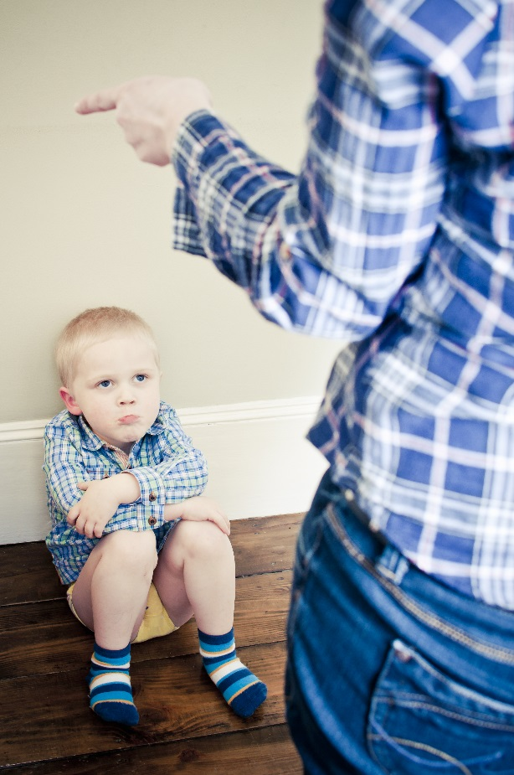
Time Out
Goal: to help child calm down or a consequence for bad behavior
2 - 7 years of age
Only 1 warning
Place in uninteresting place
1 minute/year; use timer
If child leaves, return to place, restrain
Once calm, discuss behavior, alternatives
Notes:
Principles for young children:
Only for 2-3 behaviors at one time
Practice before first use
Only one warning, none for aggression
Brief statement of offense
Place in uninteresting place
Brief, 1 min/year of age. Use timer
If leaves, restrain or use playpen
No discussion or lectures

Slide 26
Assessment - Talking with Children, Youth
How do you get along with people at home?
What kind of things do you do with them?
Who do you tell if you’re feeling bad?
All kids sometimes behave badly.
What happens when you behave badly?
What would you like to see happen?
What do you think you could do differently?
May I talk with your mom/dad about this?
Notes:
Must talk with kid
Normalize bad behavior

Slide 27
“Beat the Clock” - For Habitual Dawdling
Set timer for reasonable period
No reminders
If task done by bell → reward
If not → no reward

Slide 28
Physical Punishment in Public
Awkward, fear of intervening
What’s the worst thing that’s likely to happen?
Suggested approach
Do not admonish
Empathize
Convey wish to help, as a parent, professional
Suggest getting help from child’s doctor or nurse

Slide 29
Tom
Ms. Adams brings in 5-year-old Tom for a regular check up. She describes “occasionally popping him.” Yesterday, “he got a whupping. Broke my vase!”

Slide 30
Poll Question
This meets your state’s legal definition of physical abuse.
Yes
No

Slide 31
When to Refer to Child Welfare?
Suspected abuse or neglect
A bruise lasting 24 hours
Any physical injury
Hitting the face, head
Other concerns for abuse or neglect
Severe and/or repeated beatings – with implement
Parent resistant to alternatives

Slide 32
When to Refer for Help with Discipline Problems?
Discipline – often addressed by frontline professionals
Consider referral elsewhere if:
If persistent and/or severe problems
If other problems, such as substance misuse
Know your community resources
Behavioral health specialist

Slide 34
Resources for Parents
http://www.nationalparenthelpline.org
​http://www.ahaparenting.com/parenting-tools/positive-discipline/strict-parenting
​Fay J & Fay C. 2015. Love and Logic Magic for Early Childhood: Practical Parenting from Birth to Six Years.
Cline F & Fay J.2006. Parenting Teens With Love And Logic: Preparing Adolescents for Responsible Adulthood
Crary. Without Spanking and Spoiling: A Positive Approach to Toddler and Preschool Guidance
Mazlish E & Faber A. 2012. How to Talk So Kids Will Listen, and Listen so Kids Will Talk.
Faber A & Mazlish E. 1987. How to be the Parent You Wanted to be.
Nelsen J. 2006. Positive Discipline: The Classic Guide to Helping Children Develop Self-Discipline, Responsibility, Cooperation, and Problem-Solving Skills
Positive Discipline in Everyday Parenting - positivedisciplineeveryday.com
ACT Raising Safe Kids Program - apa.org/act

Slide 35
Core Components of the SEEK Model Practice Self-Assessment
PCPs trained
Personnel perform roles
Use SEEK PQ-Re
Procedure for parents to complete PQ-Re
Use SEEK Guidelines, Responses to Barriers
A system for documenting screening info.
Use parent handouts, customized
Referral procedures

Slide 36
Thank you and good luck! www.SEEKwellbeing.org
hdubowitz@som.umaryland.edu

