Slide 1


A Safe Environment for Every Kid
SEEK MOC 4/PI Self-Directed Clinical Activity
Webinar 2
Howard Dubowitz, MD, MS, FAAP
hdubowitz@som.umaryland.edu

Slide 2

SEEK Materials – Webinar 2
SEEK Webinar 2 PowerPoint
Motivational Interviewing
  Pediatric Clinics of North America article
  SEEK Newsletter – Motivational Interviewing
  SEEK website: Implementing SEEK – SEEK Materials – Supplemental Materials
Intimate Partner Violence
  SEEK Newsletter – Intimate Partner Violence
  AAP Clinical Report on Intimate Partner Violence

Slide 3


Slide 4
Why Use Motivational Interviewing (MI)?
Changing behavior is tough
Telling people what to do often doesn’t work
MI shown to be effective

Slide 5
What is MI?
Provider-centric → patient-centered approach
Empathic, nonjudgmental, supportive → empower parents to identify their goals, strengths, skills, barriers, solutions

Slide 6
Core Principles of MI
A collaborative, compassionate culture
4 processes
  A working relationship
  Focusing on a problem to change
  Exploring parent’s goals, barriers → motivate change
  Planning the change
Skills to understand and address concerns

Slide 7
Core Components of Motivational Interviewing (MI)
Collaboration - a partnership that honors a parent’s expertise and perspective
Exploring a parent’s thoughts, feelings, behavior, motivations and barriers to change
Autonomy - affirming a parent’s right and capacity for self-direction
Help parents identify their own goals, behaviors to change, strengths, skills, and possible solutions

Slide 8
Core Skills in MI
Ask open-ended questions
  How do you feel about your drinking?
Focus on strengths, affirm the positives
  I see how much you care about ___!
Reflection: Mirror back the parent’s perspective
  I hear you that this is hard to do.

Slide 9
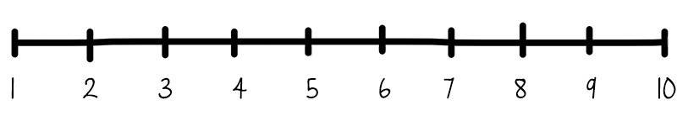
Core Skills in MI
On a scale of 1 to 10, how important is it for you to change your (behavior)?
  High: support; low: discuss why
On a scale of 1 to 10, how confident are you that you can change (behavior)?
  High: support; low: address barriers

Slide 10
Core Skills in MI
Use the “elicit-provide-elicit” technique
  Elicit: ask what parent knows or if you can offer info
    Do you mind if I tell you my concern?
  Provide info in a neutral, nonjudgmental way
    “I….” and “you…..” → What we know or studies show …….
  Elicit parent’s interpretation
    What do you make of this? How can I help?
Summarize
  You’d like to get treatment for yourself, and you’ll try, but you’re not sure if you’ll find the time

Slide 11
Examples of Reframing our Approach
I’d like to help you
  →Would you like my help?
I think your drinking really is a problem!
  What do you feel about your drinking?
You do need to cut back on your drinking!
  → What can do about your drinking?

Slide 12

Intimate Partner Violence (IPV)

Slide 13
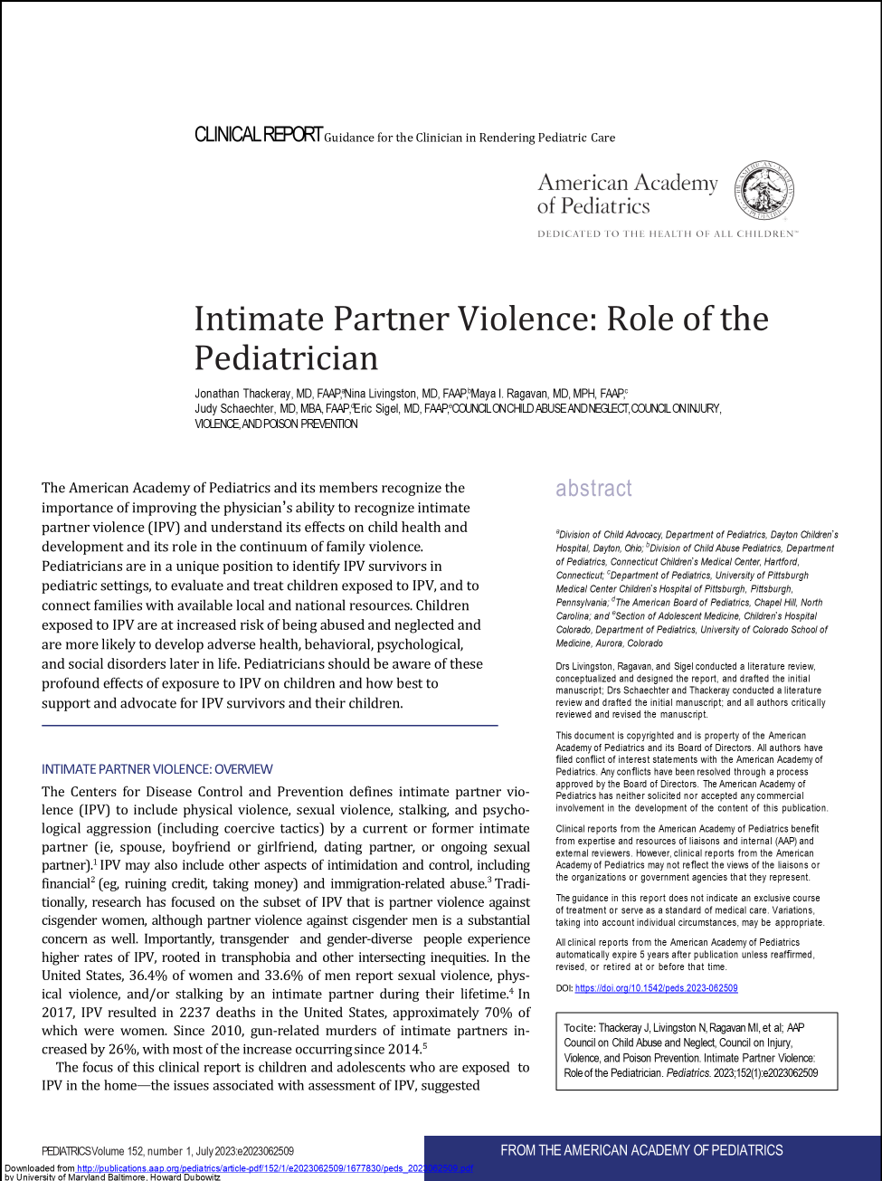
Background
IPV is prevalent
  1/3 of women & men, in their lifetime
“Profound, wide-ranging, potentially long-lasting effects on children.”
AAP: “Pediatricians are encouraged to advocate and support local and national multidisciplinary efforts to recognize, treat, and prevent IPV.”
Thackeray, et al; AAP Council on Child Abuse and Neglect, Council on Injury, Violence, and Poison Prevention. Intimate Partner Violence: Role of the Pediatrician. Pediatrics. 2023;152(1):e2023062509

Slide 14
SEEK’s REAP Approach
Reflect: It sounds like you’re having a tough time with your partner
Empathize: I’m sorry. This can be tough on you, and your child. Lots of people have rough times in relationships, but you don’t deserve to be treated this way!
Assess: Please tell me what’s going on with your partner. How’s this affecting your family? How are you dealing with this?
Plan: WITH the parent

Slide 15
Preparing Your Practice
Trained, prepared professionals, role play
Protocol
  Screening, intervention, documentation, reporting
Parent handouts
  Safety plan
  Community resources
Posters on IPV

Slide 16
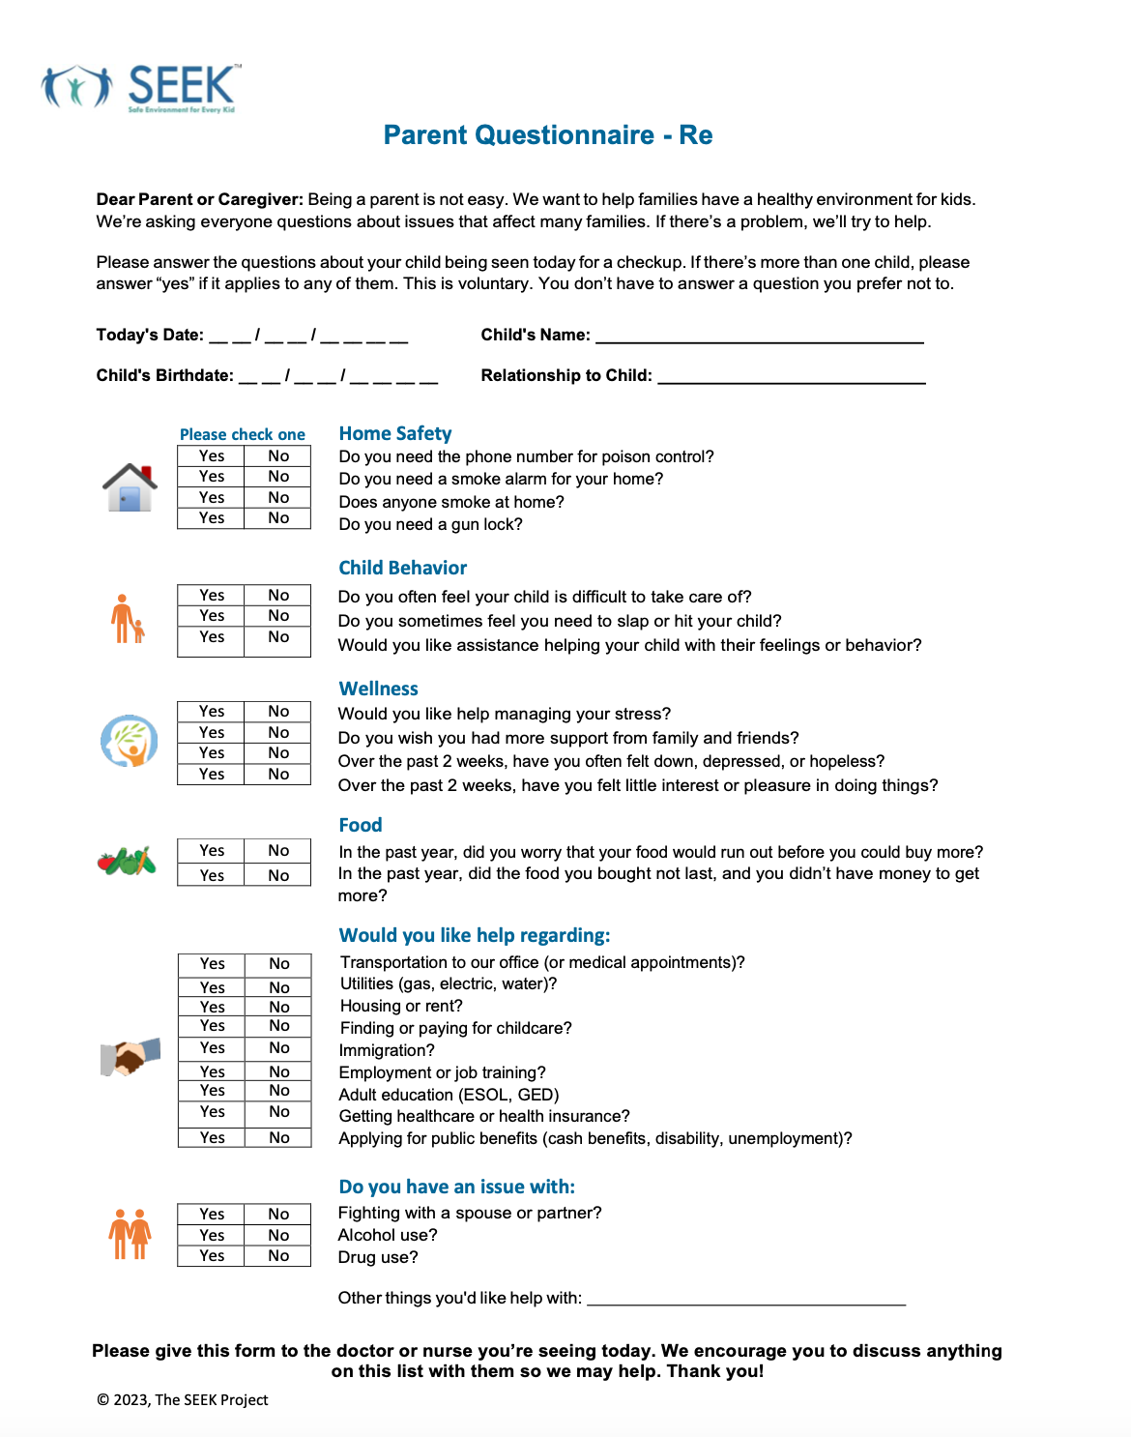
Do you have an issue with :
- Fighting with a spouse or partner?

Slide 17
General Pointers
Keep evidence of abuse, like pictures of injuries.
If you’re injured, go to your doctor or ER, report what happened.
Keep a journal of violent incidents, noting dates, events, threats. Keep your journal in a safe place.
Know where to get help. Tell someone what’s happening to you.

Slide 18
More General Pointers
Plan with your children, identify a safe place for them, like a room with a lock or a friend’s house. Reassure them that their job is to stay safe, not to protect you.
Contact your local crisis hotline to create a safety plan and find out about laws and resources before you have to use them during a crisis.
Try acquire job skills or take a course at a community college.
Try set money aside, ask friends/family to hold money for you.

Slide 19









Guidelines for Approaching Possible Partner Conflict
Do you have an issue with fighting with a spouse or partner?
Yes
I see you have a problem with your partner.
I'm sorry to hear that. It can be hard on
you, and your family.
Please tell me what’s going on with your partner.
e.g., threatens to hurt you or the children,
physical fighting, injured you, puts you down,
forced you to do something sexual
How much contact do you have with ?
Is there a gun at home?
How are you dealing with this?
What else could you try?
How’s this affecting you, your family? e.g., problems with children, sleep, eating, friends, work, stress
Are you getting help? Who/what’s helping?
e.g., talking with family or friend, religious group,
counselor, a shelter, legal help, restraining order
Would you like (more) help?
Yes No, other reason
No, getting enough help
What kind of help would you consider? e.g., talking with family or friend, DV advocate, religious group, counseling for you and/or children, a shelter, legal help, restraining order, a safety plan
What might be the benefit of getting
help?
Encourage getting help
What makes it hard to get help?
Suggest barriers, address them
What would make it easier to get help?
Offered help
Gave parent handout Made referral
in-house or community
F/U
Supported parent’s choice
Reassured
Gave parent handout F/U
No action needed
© 2023, SEEK

Slide 20
IPV: A Safety Plan
A safety plan helps keep you and your children safe
It’s a plan for escaping safely
It’s helpful in a crisis, when it’s hard to think clearly

Slide 21
IPV: A Safety Plan
A safety plan may include:
Someone to call if you sense danger, and a code or secret word. Kids know how to call 911 or a trusted contact.
Somewhere to go, and a safe way to get there. Practice this, with your child.
A hidden bag with important belongings you might need in an emergency.

Slide 22
Barrier: “It’ll get better with time”
Responses
I hear you feel things will get better with time
While some things get better with time, problems between family members often don’t, and they harm kids in the meantime
How long do you want to wait before getting help?
How would you feel about trying this program or counseling?
If not now, please let me know when you feel ready

Slide 23
Barrier: “My partner might get mad and make things worse”
Responses
I see you’re worried about your partner getting mad. This is a common concern
I’ll keep this strictly confidential. Check if your state requires this be reported
You’re right that doing something about the problem has risks. But so does doing nothing
Would you consider trying a program or counseling?

Slide 24
Child in the Room?
If possible – child not in the room
If child in the room
  Begin with general questions
  Be sensitive to parent’s comfort level
  Consider scheduling private time to talk

Slide 25
Key Information to Provide Children
I heard about the fighting at home
I’m sorry this is happening to you and your family
How does it make you feel?
It’s not your fault
If you feel unsafe, call 911, tell someone you trust
I’m going to try to help make things better
Consider referral for a mental health evaluation

Slide 26

Documentation
Document all IPV assessments
Be aware that parents can access a child’s record
A generic statement can indicate an IPV assessment, resources offered, per practice protocol
Can place with social work notes
Do not list IPV as a diagnosis

Slide 27
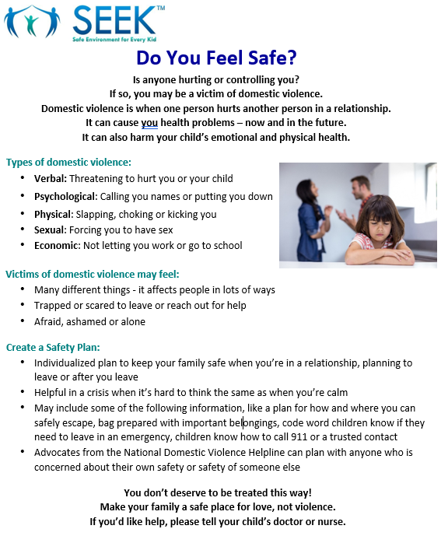
SEEK Parent Handout

Slide 28
Referral to the Department of Social Services (DSS)?
At what point does child’s exposure to IPV = CM?
  Overlap of IPV and CM
  Psychological harm
State laws and agency policies vary
  Whenever child exposed to IPV
  Only if demonstrable harm, physical
  Professional discretion

Slide 29
Referral to DSS?
Consider:
  Direct injury to the child
  Potential for danger
  Parent’s ability to plan for child’s safety
  Support and connections to community resources
  Aggravating factors?
  Alternative steps: support, information, referral

Slide 30
If a Referral is Made
Inform the (non-abusive) parent
Give DSS specific info re. potential for danger
Offer parent resources
Consider asking parent to refer himself/herself
  Avoid “failure to protect”
Offer to make referral with parent

Slide 31
Resources
WomensLaw.org - State legal information
www.thehotline.org – National Domestic Violence Hotline
www.nctsn.org – The National Child Traumatic Stress Network
www.nationalcenterdvtraumamh.org – National Center on Domestic Violence, Trauma and Mental Health
www.rainn.org - the largest national anti-sexual violence organization
Legal Aid offices - free legal assistance

Slide 32

Thank you! www.SEEKwellbeing.org
hdubowitz@som.umaryland.edu

Slide 33
Appendix

Slide 34
Safety Plan – In My Home
I can use some or all of these strategies:
I can change the locks on my doors and windows ASAP. Check your local jurisdiction for laws.
I can replace wooden doors with steel/metal doors.
I can install additional locks, window bars, poles to wedge against doors, and electronic security system.
I can install motion lights outside.
I will teach my children how to call me, 911 or a trusted person - if my partner takes them.
I will tell people who take care of my children that my partner is not permitted to pick them up.
I’ll inform my workplace if my partner shows up there.
I can inform ___ (neighbor) that my partner no longer lives with me; they should call the police if he is nearby.

Slide 35
Safety Plan – With a Protection Order
I will always carry a certified copy with me and keep a photocopy.
I will give my protection order to police departments in the community where I work and live.
I can get my protection order to describe all guns my partner may own and authorize a search for removal.
Protective orders may stop physical abuse, but psychological abuse is still possible. So, a protective order does not replace a safety plan.

Slide 36
Safety Plan - During a Violent Incident
I can use some or all of these strategies:
If I have/decide to leave, I will go ______.
I can tell _____ (neighbors) about the violence and ask them to call the police if they hear suspicious noises from my home.
I will use _____ as my code word so someone can call for help.
I will tell a trusted person my code word, so I can text them to call 911.
I can teach my children to call 911 when I say my code word.
If the situation is very serious, I can help calm him/her down. I have to protect myself until I/we are out of danger.
If I need to leave quickly, I will keep my purse ready in a specific place.

Slide 37
Safety Plan – When Planning to Leave
I can use some or all of these strategies:
I will keep copies of important documents, keys, clothes and money at ____.
I will open a savings account by __/__/__ , to increase my independence.
Other things I can do to increase my independence include:
  I will check with _______to see who would let me stay with them or lend me money. I’ll also check with a local shelter.
  If I plan to leave, I won’t tell my abuser in advance face-to-face, but I will call or leave a note from a safe place.
Resources
  WomensLaw.org - state legal information
  www.thehotline.org – National Domestic Violence Hotline

