Slide 1
A Safe Environment for Every Kid SEEK MOC 4/Performance Improvement Self-directed Clinical Activity Webinar 1
Howard Dubowitz, MD, MS, FAAP
Professor of Pediatrics

Slide 2
SEEK Materials – Webinar 1
SEEK Webinar 1 PowerPoint
SEEK Pediatric Annals article
SEEK Parent Questionnaire – Re
Guidance for the SEEK PQ-Re
SEEK Medical Record Evaluation Form
SEEK Newsletter – Finding Resources

Slide 3
SEEK: Promoting Children’s Health and Safety
Address social determinants of health, ACEs – health-related social needs
Support parents and parenting
Prevent child maltreatment (CM)
Promote children’s health, wellbeing
development and safety
Strengthen families

Slide 4
The SEEK Approach
SEEK trained primary care professionals (PCPs)
SEEK Parent Questionnaire - Re
Brief assessment of identified problems
Motivational Interviewing – SEEK Guidelines
Initially help address problems
PCP + behavioral health/SW/case manager/navigator
Knowledge of community resources
SEEK Parent Handouts – customized, alternatives

Slide 5
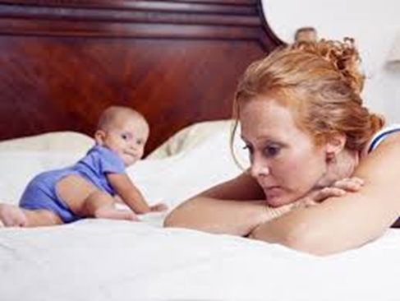
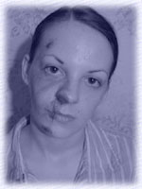
Targeted Health-related Social Needs
Depression
Major parental stress
Substance misuse
Intimate partner (domestic) violence
Harsh punishment
Food insecurity
Accessing healthcare, transportation
Childcare
Utilities, housing, rent
Adult education, employment
Public benefits
Immigration
Gun safety

Slide 6
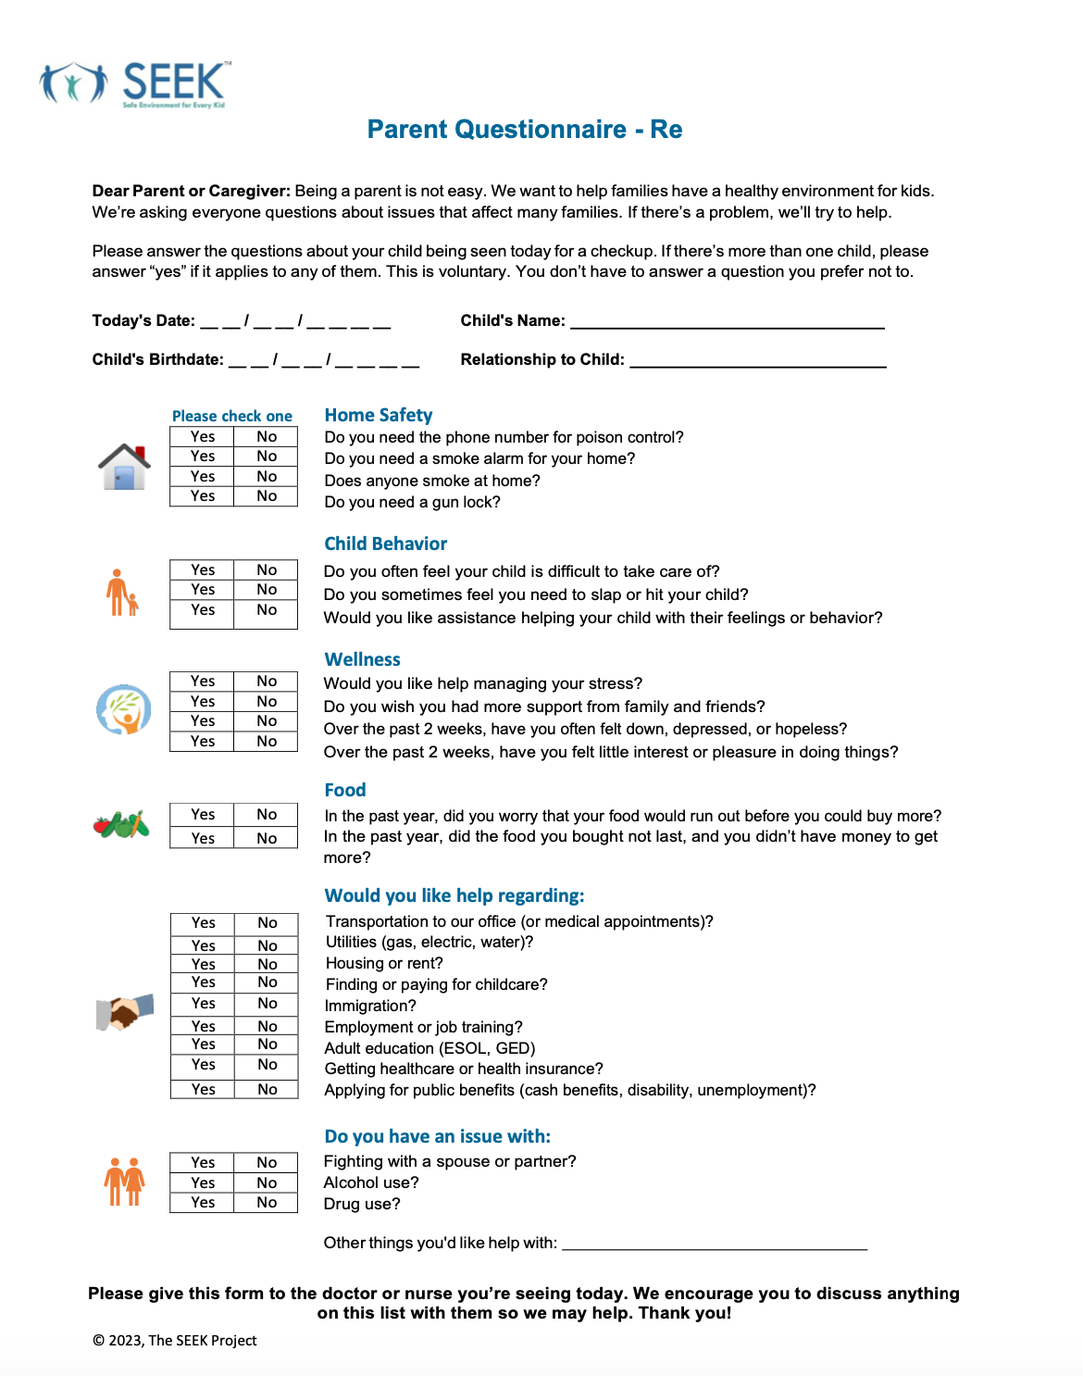
SEEK PQ-Re (Expanded)
Evidence informed
Brief
Easy to read
Answer yes/no
Flexible – content, timing
Voluntary
Different languages

Slide 7
SEEK PQ-Re Intro
Empathic: “Being a parent is not always easy”
Universal: “We’re asking everyone …”
Provide context: “We want to help families have a safe environment for kids”
Builds on what’s accepted: injury prevention, safety
Voluntary

Slide 8
How SEEK Works
Staff identify families for the PQ-Re, in advance
At start of visit, parent given SEEK PQ-Re (e.g., by MA during rooming)
Parent completes PQ-Re while waiting, in exam room
Parent gives PQ-Re to PCP
Identified problems addressed by PCP + SW/case manager/navigator
SEEK Parent Handout
Referral to community agencies
Follow up – by child’s or parent’s PCP

Slide 9
SEEK MOC 4/PI Self-Directed Clinical Activity

Slide 10
The SEEK Logic Model
SEEK PCP training
Comfort
Competence
Implement SEEK
Administer PQ-Re
Briefly assess problem(s)
Initially address problem(s)
Practice
More problems identified and addressed
Stronger families
Healthier parents
Enhanced child health, development and safety
Less child abuse and neglect

Slide 11
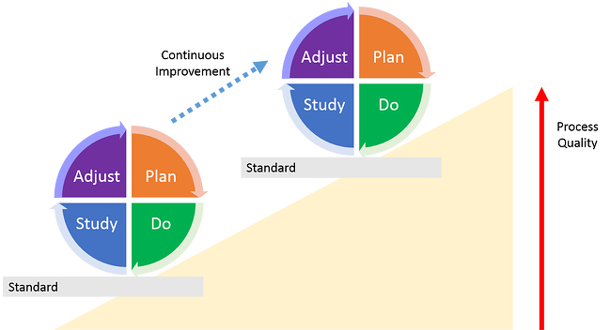
Quality Improvement (QI) Project
One project suffices for the practice
PDSA cycle
Participating PCPs need to be involved
Residents, students can help
ABP fee: $75 ABFM: free

Slide 12
QI Project
Set objective(s)
Choose measurement tool(s)
SEEK website: QI training, Implementation/Evaluation
Gather baseline data + 1 (ABFM) or 2 (ABP) further cycles
10 - 20 randomly selected charts
Use data to assess and improve implementation
Submit data at the end

Slide 13
Sample Objectives and Measures
Improve screening for health-related social needs
SEEK MOC/PI Evaluation Record
Ensure an action is taken for a positive screens
Improve PCP thinking and practice re. addressing the needs
SEEK PCPQ (or HPQ), SEEK MOC Evaluation Record
Improve parent view of child’s healthcare
SEEK Parent View of Child’s Healthcare (or Parent Satisfaction with Child’s Health Professional)

Slide 14
Getting Ready
SEEK overview paper
Dubowitz H. The Safe Environment for Every Kid model: promotion of children's health, development, and safety, and prevention of child neglect. Pediatric Annals. 2014 Nov;43(11):e271-7.
Visit SEEK website www.SEEKwellbeing.org
Training – independently, MOC 4/PI
Implementation/Core Materials
SEEK PQ-Re, Guidelines and Responses to Barriers, Parent Handouts
(Evaluation)
FAQs

Slide 15
Next Steps
Other medical professionals in the practice?
Behavioral health professional?
A “champion”
Office staff
lead person (co-champion)
roles

Slide 16
Next Steps
Decide on timing for screening, selected checkups (“SEEK” visits)
Decide what to do with the screener after the visit?
Document positive screens, actions taken
Scan into child’s record
Gather PQ-Res and assess rates of problems in families served
Needs assessment
Identify community resources, customize SEEK Parent Handouts
Gather baseline data
Pick a start date for implementing SEEK

Slide 17
Find Help (Aunt Bertha)
Comprehensive online directory of resources
Search by zip code and keywords
Filter by proximity and relevance
Findhelp.com

Slide 18
Sampling
Baseline: select a random 10-20 charts of children 0-5 who had regular checkups in the past month.
Focus only on the last “SEEK visit” (e.g., 2, 9, 15, 24, 36, 48, 60 months).
Assess issues of interest – e.g., was there screening for depression? (Was it positive? Was some action taken? What?). Document in the SEEK MOC/PI Evaluation Record Form.
Cycles 2 and 3: Again, select a random sample of 10-20 charts with a “SEEK visit” in the period of interest (e.g., the past 3 weeks).
Assess as with baseline.

Slide 19
Scoring: Screening Rate
If screening occurred for > 50% of targeted problems at a visit = screened
Numerator = number of charts/visits had screening = n
Denominator = number of charts/visits reviewed = d
Example
d = 20 charts/visits reviewed
n = 12 of them had screening
Screening rate: n/d = 60%

Slide 20
Scoring: Action Rate
Count the # of problems identified for all reviewed visits = d
Count the # of times an action was taken for those problems = n
Action rate = n/d
Example
20 charts/visits reviewed
12 problems identified in total = d
9 of them led to an action = n
Action rate: 75%

Slide 21
SEEK MOC/PI Medical Records Evaluation Form
Patient 1 | Depression | Major Stress | Substance Use | IPV | Discipline | Food Insecurity
Screen Done Y/N
Screen + Y/N
Action Taken Y/N/NA
Type of Action(s)
Consider a screen to have occurred if the record “reasonably” shows screening for the problem.
For ‘Action Taken” code:
1 – reassurance 2 – referred to in-house social work/behavioral health
3 – referred to community agency 4 – other

Slide 22
SEEK MOC/PI Medical Records Evaluation Form
Patient 1 | Depression | Major Stress | Substance Use | IPV | Discipline | Food Insecurity
Screen Done Y/N | Y | N | N | N | N | Y
Screen + Y/N | N |  |  |  |  | Y
Action Taken Y/N/NA | NA |  |  |  |  | Y
Type of Action(s) |  |  |  |  |  | 3
Consider a screen to have occurred if the record “reasonably” shows screening for the problem.
1 – reassurance 2 – referred to in-house social work/behavioral health
3 – referred to community agency 4 – other
Screening for only 2/6 targeted problem = not screened (need >50%)

Slide 23
SEEK MOC/PI Medical Records Evaluation Form
Date: Period Covered: Cycle: 1 2 3 Total # of charts reviewed:
Your Name: Practice Name:
 | # Screened | # Positive | # With an Action Taken | Types of Action Taken
Depression |  |  |  | 1 – 3 – 2 – 4 –
Major stress |  |  |  | 1 – 3 – 2 – 4 –
Substance use |  |  |  | 1 – 3 – 2 – 4 –
Partner violence |  |  |  | 1 – 3 – 2 – 4 –
Discipline |  |  |  | 1 – 3 – 2 – 4 –
Food Insecurity |  |  |  | 1 – 3 – 2 – 4 –
1 – reassurance 2 – referred to in-house SW/behavioral health
3 – referred to community agency 4 – other

Slide 24
SEEK MOC/PI Medical Records Evaluation Form
Date: 12/2/22 Period Covered: 1/7/22-1/31/22 Cycle: 1 2 3 Total # of charts reviewed: 10
Your Name: Shelly Smith Practice Name: Lakewood Pediatrics
 | # Screened | # Positive | # With an Action Taken | Types of Action Taken
Depression | 8 | 1 | 1 | 1 – 3 – 2 – 2 4 –
Major stress | 6 | 2 | 2 | 1 – 1 3 – 2 – 1 4 –
Substance use | 6 | 1 | 1 | 1 – 1 3 – 2 – 4 –
Partner violence | 6 | 0 |  | 1 – 3 – 2 – 4 –
Discipline | 6 | 2 | 1 | 1 – 3 – 2 – 4 – 1
Food Insecurity | 8 | 2 | 2 | 1 – 3 – 2 – 2 4 –
1 – reassurance 2 – referred to in-house SW/behavioral health
3 – referred to community agency 4 – other
Action taken for 7/8 identified problems. Action rate = 88%

Slide 25
SEEK MOC 4 QI Project – Screening Rate
The Screening Rate for each cycle = the # of visits with adequate screening/# of visits reviewed x 100

Slide 26
SEEK MOC 4 QI Project – Screening Rate
The Screening Rate for each cycle = the # of visits with adequate screening/# of visits reviewed x 100

Slide 27
SEEK MOC 4 QI Project – Action Rate
The Action Rate = total # of identified problems with an action taken/total # of identified problems x 100

Slide 28
SEEK MOC 4 QI Project – Action Rate
The Action Rate = total # of identified problems with an action taken/total # of identified problems x 100

Slide 29
Suggested Implementation Timeline
WEEKS 1-2
- SEEK training
- Choose “champion”
- Select target visits
- Prepare Handouts
- Plan for PQ-Re
QI Project
- Set objective(s)
- Select measure(s)
- Cycle 1 data
- Review data
- Prep staff
- Plan for referrals
- Involve SW
- Implement SEEK
WEEKS 6-8
- Webinar #2
- Cycle 2 data
- Review data
- Modify SEEK
WEEKS 3-5
WEEKS 9-10
- Cycle 3 data
- Modify SEEK
- Webinar #3
- Submit data to
Board

Slide 30
ABP – Health Care Improvement (Part 4)
Visit ABP website - https://www.abp.org
Select Health Care Improvement (Part 4)
Select Your Own QI Project - https://www.abp.org/content/your-own-qi-project
Choose according to number of participating PCPs

Slide 31
ABFM – Performance Improvement
Log into your MyABFM Portfolio
Select Performance Improvement activities
Chose Self-Directed Clinical

Slide 32
Thank You!
hdubowitz@som.umaryland.edu

